Slide 1

MINOR PROJECT-I
ON
“CHAT APPLICATION”
Mahakal Institute of Technology
Department of Computer Science and Engineering
Presented by:
Yash Gupta (0704IT191042)
Payal Gandhwani (0704CS191113)
Mohd. Sameer Qureshi (0704CS191093)
  Under the guidance of:
  Prof. Sachin Malviya
Notes:
EMC Update
October 2004

Slide 2
CONTENTS
INTRODUCTION
LITERATURE REVIEW
PROBLEM STATEMENT
ANALYSIS OVERVIEW
DESIGN OVERVIEW
SYSTEM DATABASE STRUCTURE
SCREENSHOTS
LIMITATIONS & FUTURE SCOPE
CONCLUSION
REFERENCES

Slide 3
INTRODUCTION
THIS PROJECT IS ABOUT DEMONSTRATING A CHAT APPLICATION WHICH CAN HANDLE MANY USER AT THE SAME TIME.
WE ARE DEVELOPING A GUI BASED CHAT APPLICATION, WHICH AIMS TO PROVIDE AN EASY TO USE INTERFACE.
ALL THE REGISTERED USERS ON THE PLATFORM WILL BE ABLE TO DO A LIVE CHAT.
WE ARE USING WEBSOCKET FOR SERVER TO CLIENT CONNECTION AND FOR THE DATABASE WE USE MYSQL.
SINCE IT'S A VERY BASIC APPLICATION IT WON’T SUPPORT ANY TYPE OF FILE SHARING SYSTEM.

Slide 4

LITERATURE REVIEW
1. DISCORD
VIDEO CHAT WITH TEAM - SCREEN SHARE.
TEXT CHAT WITH MULTI CHANNELS AND HASTAGS.
CONTROL OVER ROLES AND MEMBERS.
HIGH VIDEO QUALITY.
SOMETIMES COMMUNICATION IS LAGGY.
THEY SHOULD TRY TO CHANGE THE FUNCTIONALITY AND MAKE IT SIMPLE.

Slide 5

LITERATURE REVIEW
2. TELEGRAM
EASY TO USE AND USER FRIENDLY.
EASY TO CREATE ACCOUNT AND FIND MEMBERS.
SUPPORT LARGER GROUP CONSISTING SEVERAL THOUSAND PEOPLE.
SUPER SPEEDY WITH ANY KIND OF SHARING.
CANNOT DO GROUP VIDEO CALLS.
HANGING ISSUE WITH HUGE FILES OR VIDEO SHARING.

Slide 6

LITERATURE REVIEW
3. SNAPCHAT
YOU CAN USE GEOFILTERS WITH THE APP.
YOU GET TO SEE WHO IS WATCHING YOUR SNAPS.
WE GET TO KNOW IF SOMEONE TOOK SCREENSHOT.
CHAT DISAPPEAR IF WE DO NOT SAVE.
THE AUDIENCE OF SNAPCHAT IS RATHER LIMITED.
NO RESHARE OPTIONS.

Slide 7
PROBLEM DOMAIN
PEOPLE WERE NOT ABLE TO COMMUNICATE ONLINE WITH THEIR FRIENDS/FAMILY PROPERLY.
PEOPLE WERE AFRAID OF THEIR PRIVACY.
PEOPLE WERE AFRAID IF SOMEONE COULD READ THEIR CHAT WITHOUT THEIR CONSENT.
THERE IS NO WAY TO CHECK IF THE OTHER PERSON IS AVAILABLE OR NOT.
IT IS NOT FEASIBLE TO CALL SOMEONE FOR SMALL QUERIES.

Slide 8
ANALYSIS OVERVIEW
TOOLS AND TECHNOLOGY USED IN OUR PROJECT ARE
PYTHON LANGUAGE TO CODE OUR APPLICATION.
DIFFERENT TECHNOLOGY LIKE API AND WEBSOCKET.
WE USED VS CODE FOR WRITING AND DEBUGGING OF OUR CODE
WE USED MYSQL AS THE BACKBONE FOR OUR DATABASE

Slide 9
ANALYSIS OVERVIEW (CONTINUE)
HARDWARE REQUIREMENT
PROCESSOR: MINIMUM 1 GHZ; RECOMMENDED 2GHZ OR MORE.
ETHERNET CONNECTION (LAN) OR A WIRELESS ADAPTER (WI-FI)
HARD DRIVE: MINIMUM 32 GB; RECOMMENDED 64 GB OR MORE.
MEMORY (RAM): MINIMUM 1 GB; RECOMMENDED 4 GB OR ABOVE.
SOFTWARE REQUIREMENT
OPERATING SYSTEM: WINDOWS: 7 OR NEWER, MAC: OS X V10.7 OR HIGHER, LINUX:UBUNTU.
PYTHON 3.X INSTALLED ON THE SYSTEM.

Slide 10
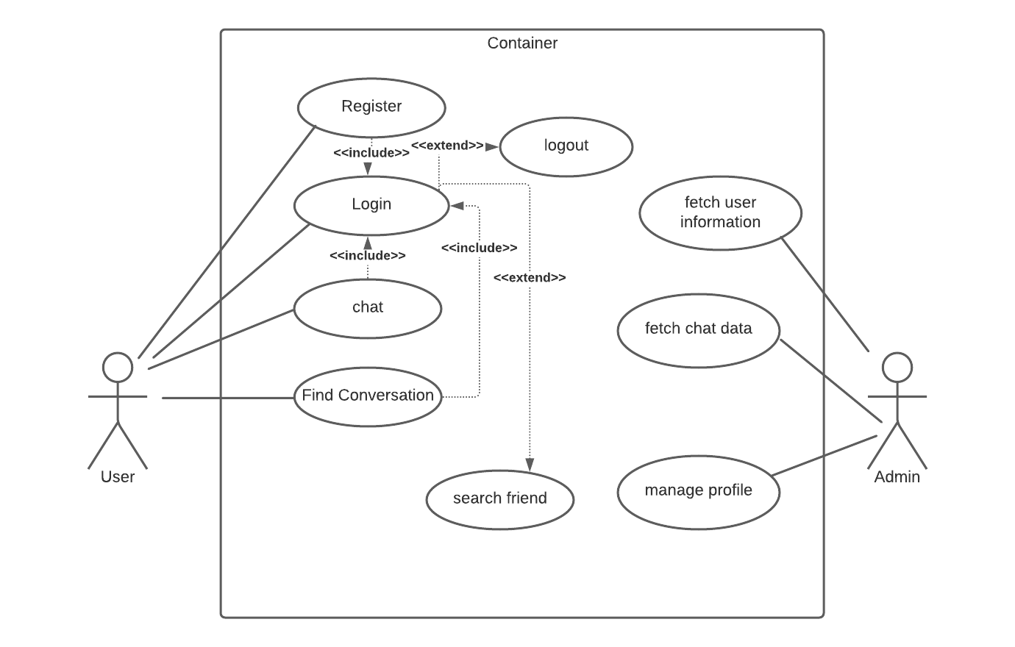
DESIGN OVERVIEW
Use case Diagram:

Slide 11
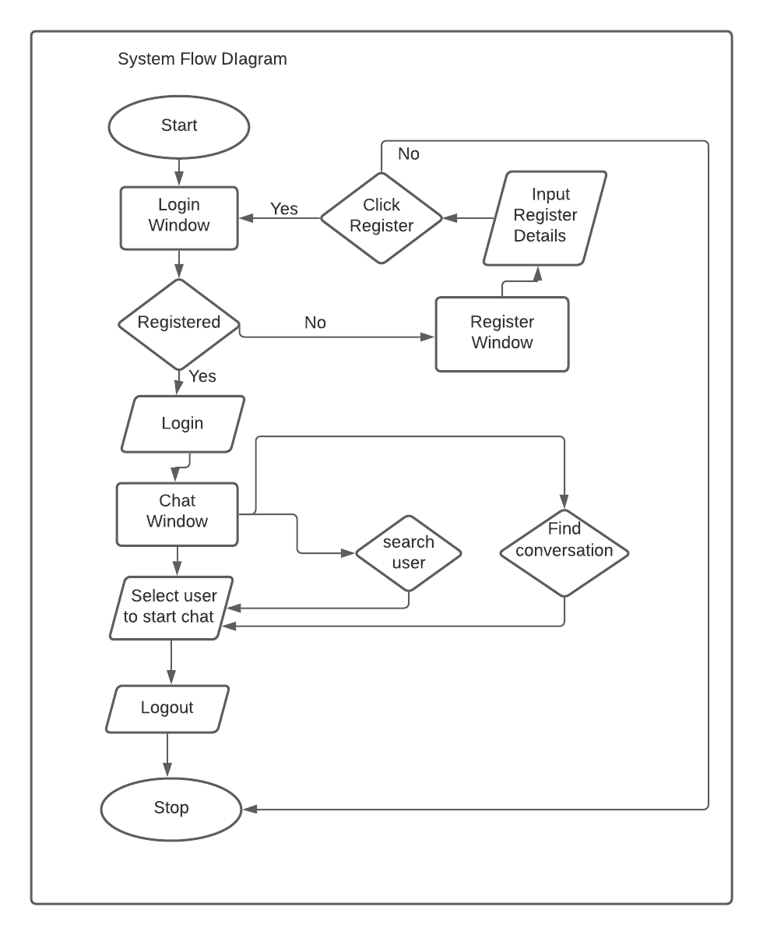
SYSTEM FLOW DIAGRAM :

Slide 12
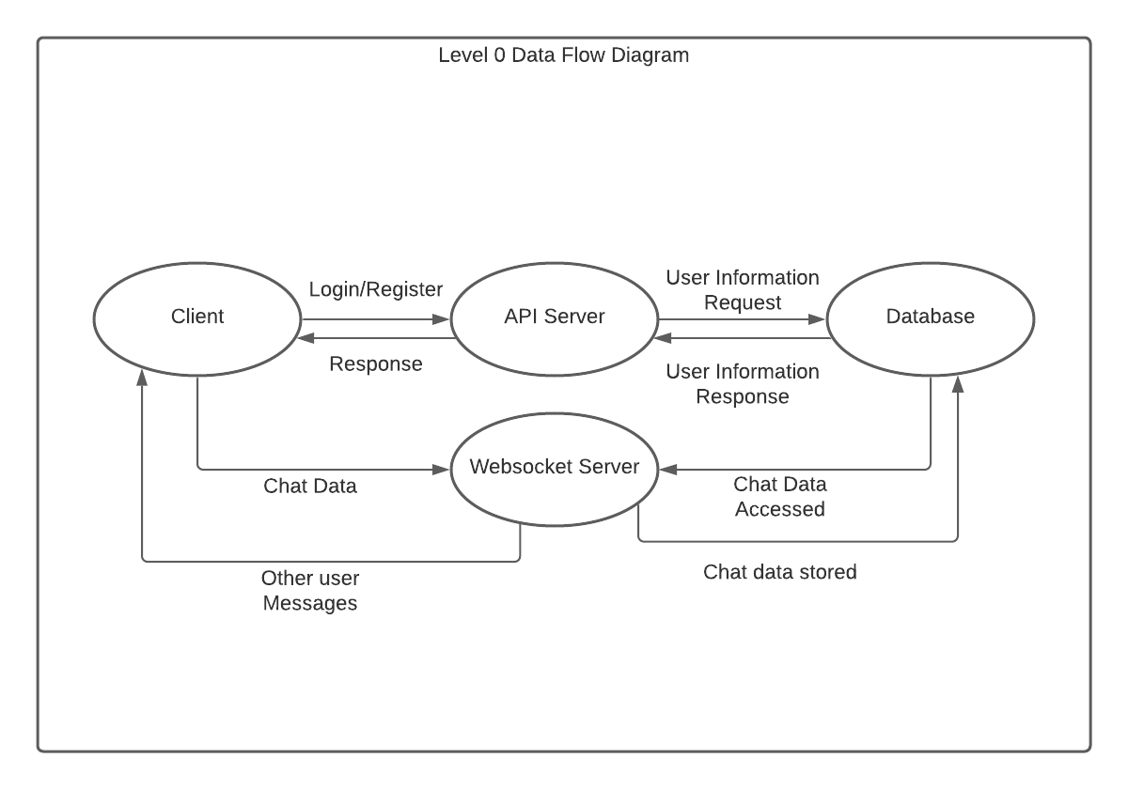
DATA FLOW DIAGRAM :
LEVEL 0 DATA FLOW DIAGRAM

Slide 13
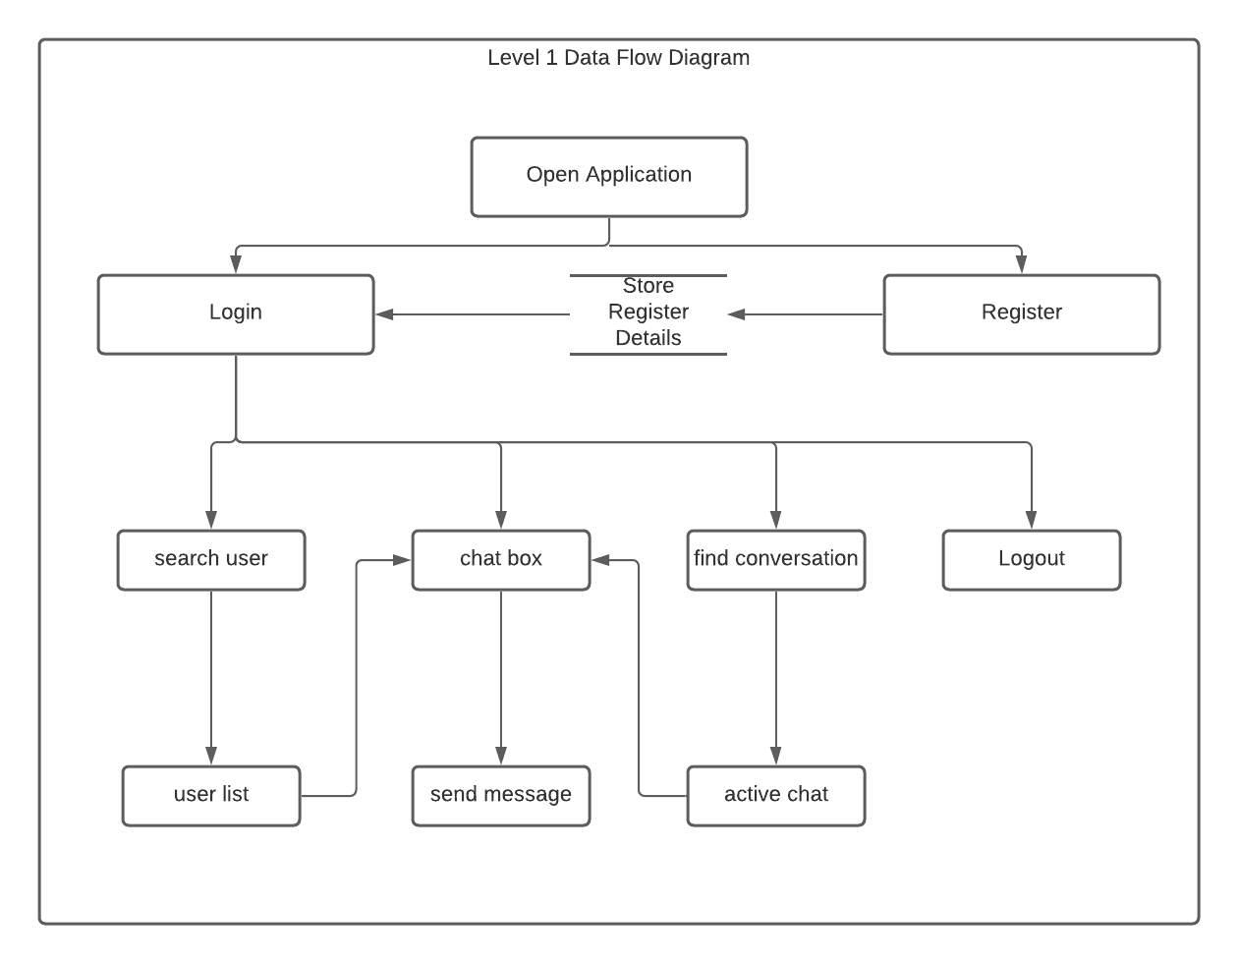
DATA FLOW DIAGRAM (CONTINUE)
LEVEL 1 DATA FLOW DIAGRAM

Slide 14
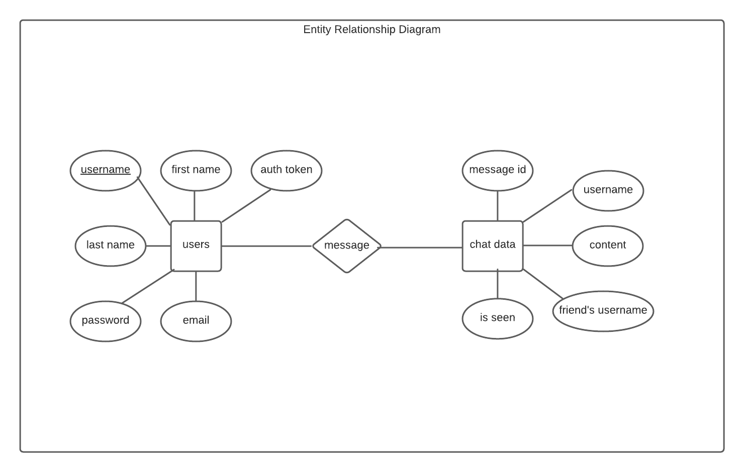
ENTITY RELATIONSHIP DIAGRAM :

Slide 15
DATA DICTIONARY DIAGRAM:
Table Name |  | users
Description |  | This table provides all the registered users on the application
Primary Key |  | username
S. No. | Data Value |  | Data Type | Description
1 | username |  | varchar | It stores the username of user
2 | first_name |  | char | It stores the first name of user
3 | last_name |  | char | It stores the last name of user
4 | email |  | varchar | It stores Email of the user
5 | password |  | varchar | It stores Password of the user
6 | authToken |  | varchar | It stores the generated unique authToken of the user

Slide 16
DATA DICTIONARY (CONTINUE):
Table Name |  | chat_data
Description |  | This table provides all the chat information sent by a user to a user
S. No. | Data Value |  | Data Type | Description
1 | username |  | varchar | It stores the username of user
2 | friend_username |  | varchar | It stores the username of friend
3 | content |  | varchar | Message
4 | message_id |  | integer | It stores the unique Message ID
5 | is_seen |  | boolean | It stores Password of the user

Slide 17
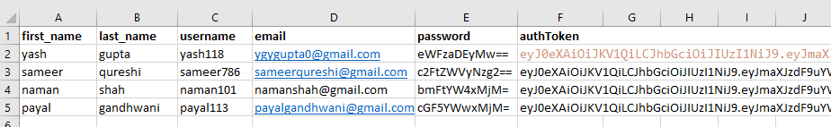
SYSTEM DATABASE STRUCTURE

Slide 18
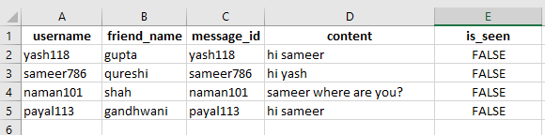
SYSTEM DATABASE STRUCTURE (CONTINUE)

Slide 19
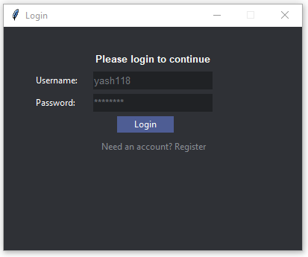
SCREENSHOTS

Slide 20
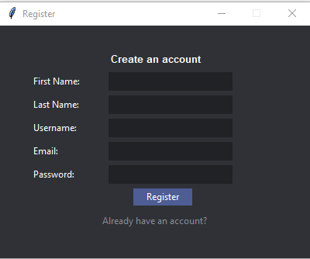
SCREENSHOTS

Slide 21
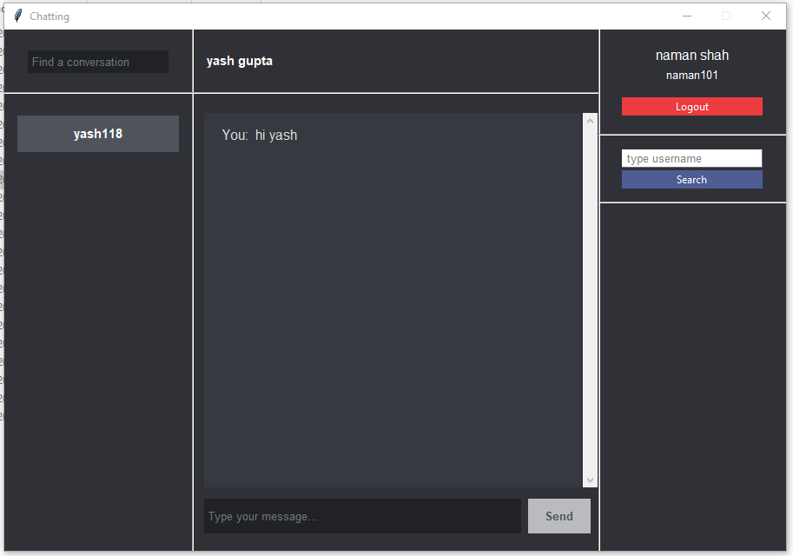
SCREENSHOTS

Slide 22
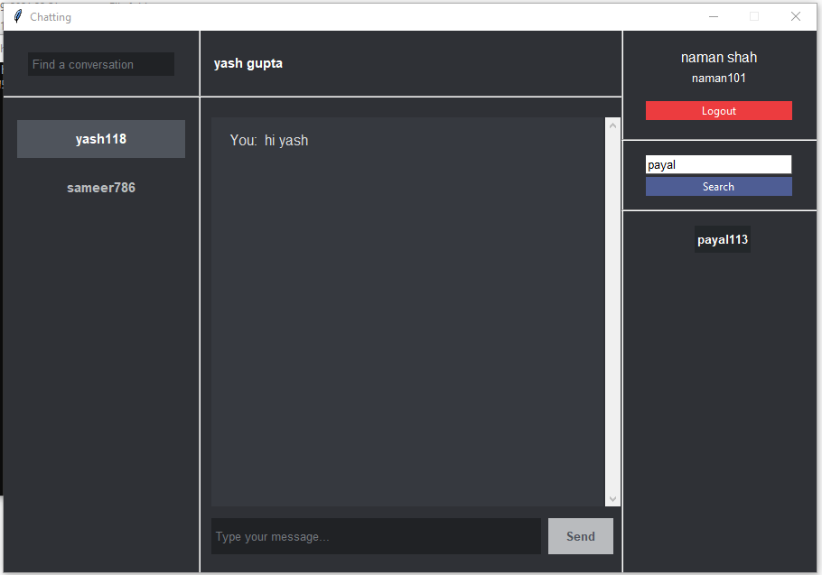
SCREENSHOTS

Slide 23
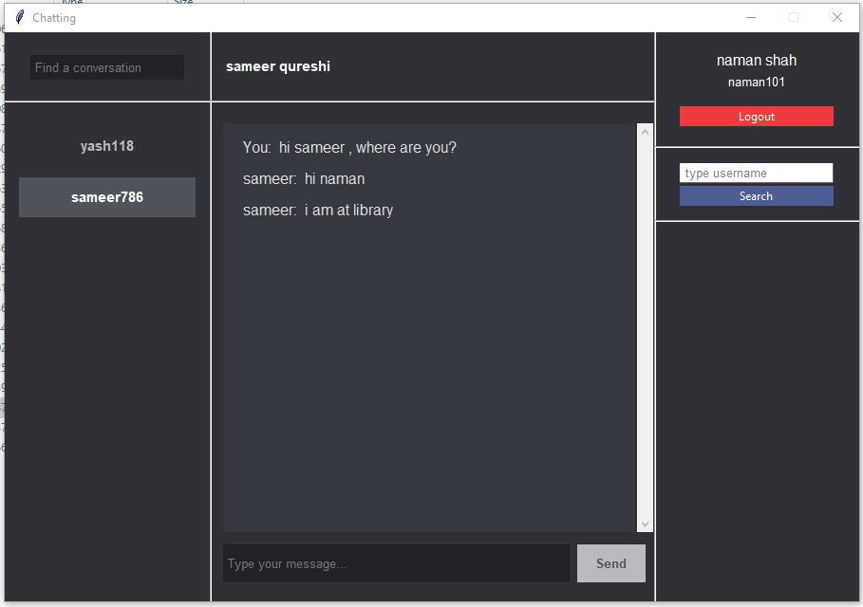
SCREENSHOTS

Slide 24

SCREENSHOTS

Slide 25
LIMITATION AND FUTURE SCOPE
THE LIMITATIONS OF OUR APPLICATION IS:
SOKO DOES NOT SUPPORT GROUP CHAT.
SOKO DOES NOT SUPPORT VOICE CALLS.
YOU CANNOT SEND IMAGES OR ANY OTHER MEDIA IN CHAT.
YOU WILL NOT KNOW IF OTHER PERSON IS ONLINE OR NOT.
YOU CANNOT CHANGE YOUR ACCOUNT PASSWORD.
YOU CANNOT CHANGE YOUR ACCOUNT PROFILE.
YOU CANNOT UNSEND YOUR MESSAGES.

Slide 26
LIMITATION AND FUTURE SCOPE
THE FUTURE SCOPE OF OUR CHAT APPLICATION IS
YOU WILL BE ABLE TO CHECK WHETHER YOUR FRIEND IS ONLINE OR NOT.
YOU WILL BE ABLE TO PERFORM GROUP CHAT.
VOICE CALLS WILL BE INTRODUCED.
YOU WILL BE ABLE TO MAKE CHANGES IN YOUR PROFILE.
YOU WILL BE ABLE TO DELETE MESSAGES.
YOU WILL BE ABLE TO SHARE IMAGES/AUDIO AND OTHER MEDIA.

Slide 27
CONCLUSION
WITH SOKO USERS WILL BE ABLE TO CHAT WITH THEIR FRIENDS AND FAMILY ONLINE.
PEOPLE WILL ONLY NEED USERNAME TO CONNECT WITH THEIR FRIENDS.
EASY TO USE, EASY TO REGISTER.
SOKO USES ENCRYPTION FOR ITS MESSAGE EXCHANGE AND PASSWORD DATABASE, SO USERS DOES NOT HAVE TO WORRY ABOUT THEIR PRIVACY.
RICH USER INTERFACE GIVES YOU WONDERFUL EXPERIENCE.

Slide 28
REFERENCES
[1] HTTPS://WWW.W3SCHOOLS.COM/PYTHON/
[2] HTTPS://WWW.W3SCHOOLS.COM/SQL
[3] HTTPS://WWW.GEEKSFORGEEKS.ORG/PYTHON-GUI-TKINTER/
[4] HTTPS://WWW.JAVATPOINT.COM/PYTHON-TKINTER
[5] HTTPS://WWW.JAVATPOINT.COM/PYTHON-MYSQL-DATABASE-CONNECTION
[6] HTTPS://WWW.JAVATPOINT.COM/PYTHON-OBJECTS-CLASSES
[7] HTTPS://WWW.TUTORIALSPOINT.COM/PYTHON/TK_FRAME.HTM
[8] HTTPS://PYTHONBASICS.ORG/TKINTER-FRAME/
[9] HTTPS://WWW.W3SCHOOLS.COM/SQL/SQL_SELECT.ASP
[10] HTTPS://WWW.W3SCHOOLS.COM/SQL/SQL_INSERT.ASP
[11] HTTPS://WWW.W3SCHOOLS.COM/SQL/SQL_MIN_MAX.ASP
[12] HTTPS://WWW.W3SCHOOLS.COM/SQL/SQL_QUICKREF.ASP
[13] HTTPS://WWW.W3SCHOOLS.COM/PYTHON/PYTHON_LAMBDA.ASP
[14] HTTPS://WWW.W3SCHOOLS.COM/PYTHON/PYTHON_FUNCTIONS.ASP

Slide 29
ANY QUERY ?

Slide 30
THANK YOU

